Slide 1
Notes:
All around us, particularly in nature and in the world of mathematics, we see strange and complex objects that cannot be really understood, measured or explained with conventional geometry.
This is the Mandelbrot set – an example of a fractal
Only recently, since the advent of modern computing, has the world of fractal geometry become open to us as a means to explain the shapes of these objects.
Self similar
Rivers, clouds, coastlines, mountains, plants, lightening, vegetation cover, snowflakes, animals and in their behavior, in our own bodies, archietecture and in the financial markets
Latst https://www.youtube.com/watch?v=ohzJV980PIQ
http://www.youtube.com/watch?v=n7JLHxBm0eY

Slide 5
The Mandelbrot set

Slide 6
Complex numbers
1 × 1 = 1
-1 × 1 = -1
1 × -1 = -1

Slide 7
Complex numbers
1 × 1 = 1
-1 × 1 = -1
1 × -1 = -1
-1 × -1 = 1

Slide 8
Complex numbers
1 × 1 = 1
-1 × 1 = -1
1 × -1 = -1
-1 × -1 = 1
x
a
b
x×(a+b) = x×a + x×b

Slide 9
Complex numbers
1 × 1 = 1
-1 × 1 = -1
1 × -1 = -1
-1 × -1 = 1
x
a
b
x×(a+b) = x×a + x×b
-1×(3-2) = -1×3 + -1×-2

Slide 10
Complex numbers
1 × 1 = 1
-1 × 1 = -1
1 × -1 = -1
-1 × -1 = 1
x
a
b
x×(a+b) = x×a + x×b
-1×(3-2) = -1×3 + -1×-2 = -3 + -1×-2

Slide 11
Complex numbers
1 × 1 = 1
-1 × 1 = -1
1 × -1 = -1
-1 × -1 = 1
x
a
b
x×(a+b) = x×a + x×b
-1×(3-2) = -1×3 + -1×-2 = -3 + -1×-2
-1×(3-2) = -1×1 = -1

Slide 12
Complex numbers
1 × 1 = 1
-1 × 1 = -1
1 × -1 = -1
-1 × -1 = 1
x
a
b
x×(a+b) = x×a + x×b
-1×(3-2) = -1×3 + -1×-2 = -3 + -1×-2
-1×(3-2) = -1×1 = -1
-1 = -3 + -1×-2

Slide 13
Complex numbers
1 × 1 = 1
-1 × 1 = -1
1 × -1 = -1
-1 × -1 = 1
x
a
b
x×(a+b) = x×a + x×b
-1×(3-2) = -1×3 + -1×-2 = -3 + -1×-2
-1×(3-2) = -1×1 = -1
-1 = -3 + -1×-2
So 2 = -1×-2 

Slide 14
Complex numbers
1 × 1 = 1
-1 × 1 = -1
1 × -1 = -1
-1 × -1 = 1
x
a
b
x×(a+b) = x×a + x×b
-1×(3-2) = -1×3 + -1×-2 = -3 + -1×-2
-1×(3-2) = -1×1 = -1
-1 = -3 + -1×-2
So 2 = -1×-2 

Slide 15
The complex plane

Slide 16
The complex plane
Complex
X
b
Real
a

Slide 17
Complex
Real

Slide 18
Complex
r = 2
Real

Slide 19
The Mandelbrot set
Z Z² + C
C is given by your position on the complex plane

Slide 20
The Mandelbrot set
Z Z² + C
C is given by your position on the complex plane
Start with z = 0 and repeatedly apply the transformation

Slide 21
The Mandelbrot set
Z Z² + C
C is given by your position on the complex plane
Start with z = 0 and repeatedly apply the transformation
If the sequence of numbers that comes from this increases to infinity c is in the set, otherwise c is outside the set

Slide 23
(Filled in) Julia sets

Slide 24
(Filled in) Julia sets
Z Z² + C
C is a constant, every value of C gives a different Julia set
Start with z given by the position on the complex plane and repeatedly apply the transformation
If the sequence of numbers that comes from this increases to infinity c is in the set, otherwise c is outside the set
c = -0.738281 + 0.218750i
Notes:
Julia set is the boundary of the filled in julia set.

Slide 26
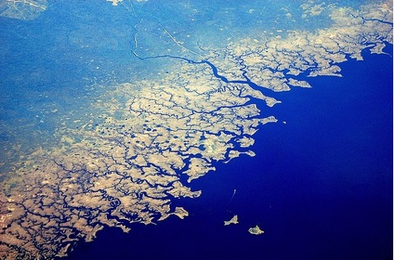

Slide 27
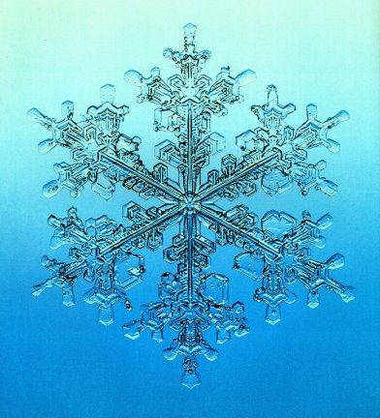

Slide 28
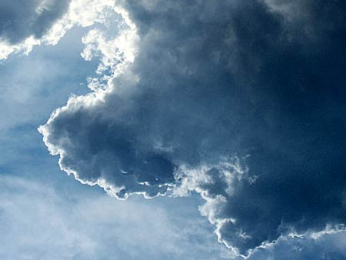

Slide 29
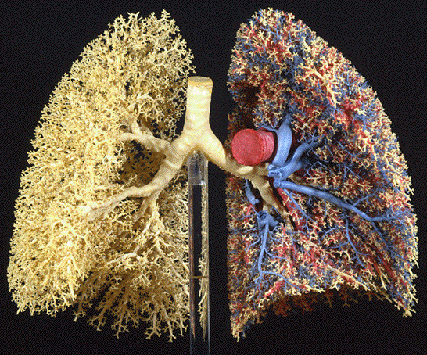

Slide 30
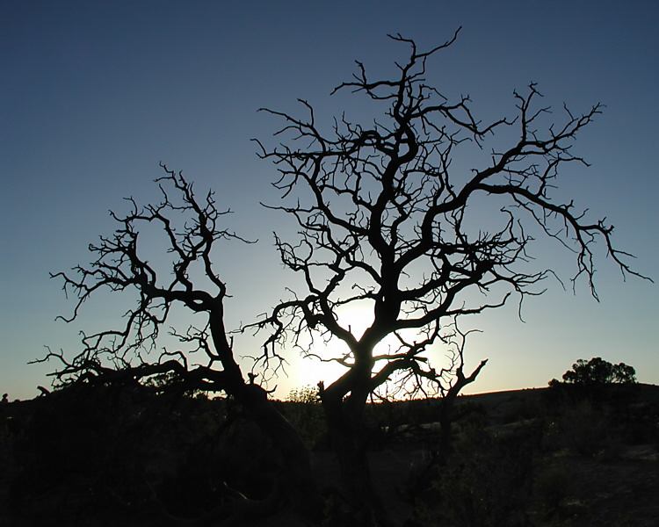
Notes:
http://www.google.co.uk/imgres?q=fractal%3B+tree&hl=en&gbv=2&biw=1280&bih=721&tbm=isch&tbnid=DzQM7_2E_RoCRM:&imgrefurl=http://www.pbase.com/rwalkernm/image/41202777&docid=lvezl3WCRgEX4M&imgurl=http://ic2.pbase.com/u32/rwalkernm/upload/41202777.FractalTree.jpg&w=750&h=600&ei=AGlbT_CAL4G_0QXA0dznCg&zoom=1&iact=hc&vpx=533&vpy=212&dur=945&hovh=201&hovw=251&tx=168&ty=138&sig=114573368585156778329&page=3&tbnh=161&tbnw=213&start=37&ndsp=20&ved=1t:429,r:12,s:37

Slide 31
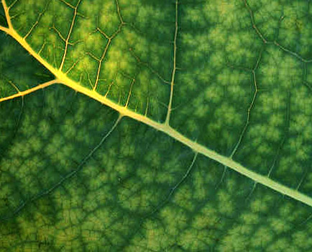

Slide 32
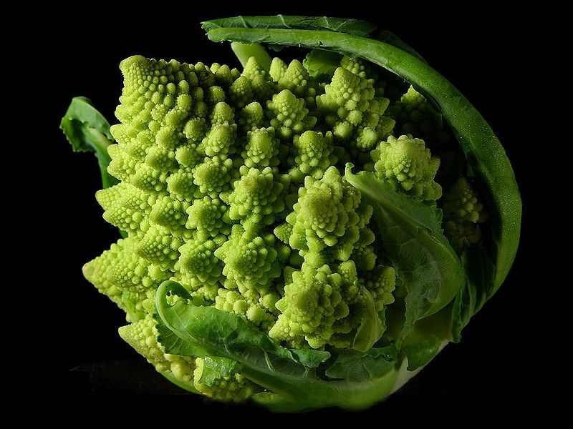

Slide 33
What is a fractal

Slide 34
What is not a fractal
A line twice as wide is twice as big
Dimension 1

Slide 35
What is not a fractal
A line twice as wide is twice as big
Dimension 1
Width
1
2
3
4
Size
1 = 1¹
2 = 2¹
3 = 3¹
4 = 4¹

Slide 36
What is not a fractal
A square twice as wide is four times as big
Dimension 2

Slide 37
What is not a fractal
A square twice as wide is four times as big
Dimension 2
Width
1
2
3
4
Size
1 = 1²
4 = 2²
9 = 3²
16 = 4²

Slide 38
What is not a fractal
A cube twice as wide is eight times as big
Dimension 3

Slide 39
What is not a fractal
A cube twice as wide is eight times as big
Dimension 3
Width
1
2
3
4
Size
1 = 1³
8 = 2³
27 = 3³
64 = 4³

Slide 40
What is a fractal

Slide 41
What is a fractal
Dimension that is not a whole number
Self similar

Slide 42
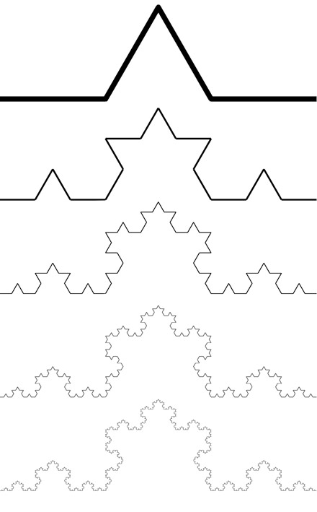
Koch Curve
Notes:
Miquel.com
Simplygreen.co.za
http://www.ibercivis.net/index.php?module=public&section=channels&action=view&id_channel=3&id_subchannel=133
http://therealsasha.files.wordpress.com/2011/10/snowflake-fractal.jpg
http://classes.yale.edu/fractals/panorama/Biology/Physiology/Physiology.html

Slide 43
Koch Curve
Notes:
Miquel.com
Simplygreen.co.za
http://www.ibercivis.net/index.php?module=public&section=channels&action=view&id_channel=3&id_subchannel=133
http://therealsasha.files.wordpress.com/2011/10/snowflake-fractal.jpg
http://classes.yale.edu/fractals/panorama/Biology/Physiology/Physiology.html

Slide 44
Koch Curve
Notes:
Miquel.com
Simplygreen.co.za
http://www.ibercivis.net/index.php?module=public&section=channels&action=view&id_channel=3&id_subchannel=133
http://therealsasha.files.wordpress.com/2011/10/snowflake-fractal.jpg
http://classes.yale.edu/fractals/panorama/Biology/Physiology/Physiology.html

Slide 45
Koch Curve
Notes:
Miquel.com
Simplygreen.co.za
http://www.ibercivis.net/index.php?module=public&section=channels&action=view&id_channel=3&id_subchannel=133
http://therealsasha.files.wordpress.com/2011/10/snowflake-fractal.jpg
http://classes.yale.edu/fractals/panorama/Biology/Physiology/Physiology.html

Slide 46
Koch Curve
Notes:
Miquel.com
Simplygreen.co.za
http://www.ibercivis.net/index.php?module=public&section=channels&action=view&id_channel=3&id_subchannel=133
http://therealsasha.files.wordpress.com/2011/10/snowflake-fractal.jpg
http://classes.yale.edu/fractals/panorama/Biology/Physiology/Physiology.html

Slide 47
Koch Curve
Notes:
Miquel.com
Simplygreen.co.za
http://www.ibercivis.net/index.php?module=public&section=channels&action=view&id_channel=3&id_subchannel=133
http://therealsasha.files.wordpress.com/2011/10/snowflake-fractal.jpg
http://classes.yale.edu/fractals/panorama/Biology/Physiology/Physiology.html

Slide 48
Koch Curve
Dimension
1
2
Width
3
3
Size
= 3¹
9 = 3²
Notes:
Miquel.com
Simplygreen.co.za
http://www.ibercivis.net/index.php?module=public&section=channels&action=view&id_channel=3&id_subchannel=133
http://therealsasha.files.wordpress.com/2011/10/snowflake-fractal.jpg
http://mthwww.uwc.edu/wwwmahes/mahes/index_000.htm
http://classes.yale.edu/fractals/panorama/Biology/Physiology/Physiology.html

Slide 49
Koch Curve
Dimension
1
2
Koch curve
Width
3
3
3
Size
= 3¹
9 = 3²
4
Notes:
Miquel.com
Simplygreen.co.za
http://www.ibercivis.net/index.php?module=public&section=channels&action=view&id_channel=3&id_subchannel=133
http://therealsasha.files.wordpress.com/2011/10/snowflake-fractal.jpg
http://mthwww.uwc.edu/wwwmahes/mahes/index_000.htm
http://classes.yale.edu/fractals/panorama/Biology/Physiology/Physiology.html

Slide 50
Koch Curve
Dimension
1
2
x
Width
3
3
3
Size
= 3¹
9 = 3²
4 = 3^{x}
Notes:
Miquel.com
Simplygreen.co.za
http://www.ibercivis.net/index.php?module=public&section=channels&action=view&id_channel=3&id_subchannel=133
http://therealsasha.files.wordpress.com/2011/10/snowflake-fractal.jpg
http://classes.yale.edu/fractals/panorama/Biology/Physiology/Physiology.html

Slide 51
Koch Curve
Dimension
1
2
x
Width
3
3
3
Size
= 3¹
9 = 3²
4 = 3^{x}
Notes:
Miquel.com
Simplygreen.co.za
http://www.ibercivis.net/index.php?module=public&section=channels&action=view&id_channel=3&id_subchannel=133
http://therealsasha.files.wordpress.com/2011/10/snowflake-fractal.jpg
http://classes.yale.edu/fractals/panorama/Biology/Physiology/Physiology.html

Slide 52
Koch Curve
Dimension
1
2
x
Width
3
3
3
Size
= 3¹
9 = 3²
4 = 3^{x}
Notes:
Miquel.com
Simplygreen.co.za
http://www.ibercivis.net/index.php?module=public&section=channels&action=view&id_channel=3&id_subchannel=133
http://therealsasha.files.wordpress.com/2011/10/snowflake-fractal.jpg
http://classes.yale.edu/fractals/panorama/Biology/Physiology/Physiology.html

Slide 53
Koch Curve
Dimension
1
2
x
Width
3
3
3
Size
= 3¹
9 = 3²
4 = 3^{x}
Notes:
Miquel.com
Simplygreen.co.za
http://www.ibercivis.net/index.php?module=public&section=channels&action=view&id_channel=3&id_subchannel=133
http://therealsasha.files.wordpress.com/2011/10/snowflake-fractal.jpg
http://classes.yale.edu/fractals/panorama/Biology/Physiology/Physiology.html

Slide 54
Koch Curve
Dimension
1
2
x
Width
3
3
3
Size
= 3¹
9 = 3²
4 = 3^{x}
Notes:
Miquel.com
Simplygreen.co.za
http://www.ibercivis.net/index.php?module=public&section=channels&action=view&id_channel=3&id_subchannel=133
http://therealsasha.files.wordpress.com/2011/10/snowflake-fractal.jpg
http://classes.yale.edu/fractals/panorama/Biology/Physiology/Physiology.html

Slide 55
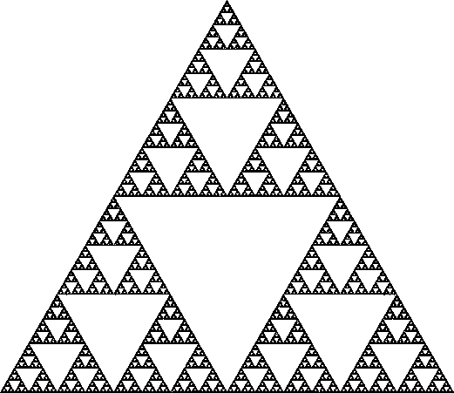
Sierpinski gasket

Slide 56
Sierpinski gasket

Slide 58
Measuring length and dimension:
the stick method

Slide 59
r

Slide 60
3

Slide 61
4

Slide 62
5

Slide 63
6

Slide 64
r
2π/2n
n
r sin (π/n)

Slide 65
Log (total length)
Log (length of side)
Notes:
Coastline length vs. Stick length

Slide 66
Log (total length)
Log (length of side)
Notes:
Coastline length vs. Stick length

Slide 67
Measuring dimension – stick method
3

Slide 68
Measuring dimension – stick method
7/2
=3.5

Slide 69
Measuring dimension – stick method
16/4
=4

Slide 70
Measuring dimension – stick method
35/8
=4.38

Slide 71
The dimension of various coastlines

Slide 72
Fractal dimension D = 1 - gradient
Log (total length)
Intercept gives
an idea of size
Log (length of stick)
Notes:
Trunk diameter – means something different for different sizes of organisms

Slide 73
The dimension of various coastlines
D = 1.18 for this example
D = 1.25 for the west coast of Britain,
D = 1.15 for the land frontier of Germany,
D = 1.14 for the land frontier of Portugal,
D = 1.13 for the Australian coast, and
D = 1.02 for the South African coast,

Slide 74
The dimension of various coastlines
D = 1.18 for this example
D = 1.25 for the west coast of Britain,
D = 1.15 for the land frontier of Germany,
D = 1.14 for the land frontier of Portugal,
D = 1.13 for the Australian coast, and
D = 1.02 for the South African coast,

Slide 75
The stick method formalized
Total length (stick length)
Dimension
Constant
Stick length
Notes:
It’s in the limit of delta -> 0
Think about what happens when D = 1

Slide 76
The stick method formalized
Total length (stick length)
Dimension
Constant
Stick length
intercept
gradient

Slide 77
Fractal dimension D = 1 - gradient
Log (total length)
Intercept gives
an idea of size
Log (length of stick)
Notes:
Trunk diameter – means something different for different sizes of organisms

Slide 78
Log (total length)
Log (length of stick)

Slide 79
Non fractal behavior
Fractal behavior
Non fractal behavior
Log (total length)
Log (length of stick)
Halley et al.
Notes:
Or different fractal dimensions at different scales

Slide 80
Non fractal behavior
Fractal behavior A
Fractal behavior B
Log (total length)
Log (length of stick)
Notes:
Or different fractal dimensions at different scales
Talk about a ball on a string

Slide 81
Koch Curve
1
Notes:
Miquel.com
Simplygreen.co.za
http://www.ibercivis.net/index.php?module=public&section=channels&action=view&id_channel=3&id_subchannel=133
http://therealsasha.files.wordpress.com/2011/10/snowflake-fractal.jpg
http://mthwww.uwc.edu/wwwmahes/mahes/index_000.htm
http://classes.yale.edu/fractals/panorama/Biology/Physiology/Physiology.html

Slide 82
Koch Curve
1
Stick size
1
Length
1
Notes:
Miquel.com
Simplygreen.co.za
http://www.ibercivis.net/index.php?module=public&section=channels&action=view&id_channel=3&id_subchannel=133
http://therealsasha.files.wordpress.com/2011/10/snowflake-fractal.jpg
http://mthwww.uwc.edu/wwwmahes/mahes/index_000.htm
http://classes.yale.edu/fractals/panorama/Biology/Physiology/Physiology.html

Slide 83
Koch Curve
1
Stick size
1
1/3
Length
1
4 × 1/3
Notes:
Miquel.com
Simplygreen.co.za
http://www.ibercivis.net/index.php?module=public&section=channels&action=view&id_channel=3&id_subchannel=133
http://therealsasha.files.wordpress.com/2011/10/snowflake-fractal.jpg
http://mthwww.uwc.edu/wwwmahes/mahes/index_000.htm
http://classes.yale.edu/fractals/panorama/Biology/Physiology/Physiology.html

Slide 84
Koch Curve
1
Stick size
1
1/3
1/9
Length
1
4 × 1/3
16 × 1/9
Notes:
Miquel.com
Simplygreen.co.za
http://www.ibercivis.net/index.php?module=public&section=channels&action=view&id_channel=3&id_subchannel=133
http://therealsasha.files.wordpress.com/2011/10/snowflake-fractal.jpg
http://mthwww.uwc.edu/wwwmahes/mahes/index_000.htm
http://classes.yale.edu/fractals/panorama/Biology/Physiology/Physiology.html

Slide 85
Koch Curve
1
Stick size
1
1/3
1/9
1/27
Length
1
4 × 1/3
16 × 1/9
64 × 1/27
Notes:
Miquel.com
Simplygreen.co.za
http://www.ibercivis.net/index.php?module=public&section=channels&action=view&id_channel=3&id_subchannel=133
http://therealsasha.files.wordpress.com/2011/10/snowflake-fractal.jpg
http://mthwww.uwc.edu/wwwmahes/mahes/index_000.htm
http://classes.yale.edu/fractals/panorama/Biology/Physiology/Physiology.html

Slide 86
Koch Curve
1
Stick size
1
1/3
1/9
1/27
3^{-n}
Length
1
4 × 1/3
16 × 1/9
64 × 1/27
4^{n} × 3^{-n}
Notes:
Miquel.com
Simplygreen.co.za
http://www.ibercivis.net/index.php?module=public&section=channels&action=view&id_channel=3&id_subchannel=133
http://therealsasha.files.wordpress.com/2011/10/snowflake-fractal.jpg
http://mthwww.uwc.edu/wwwmahes/mahes/index_000.htm
http://classes.yale.edu/fractals/panorama/Biology/Physiology/Physiology.html

Slide 87
Koch Curve
1
Stick size
1
1/3
1/9
1/27
3^{-n}
Length
1
4 × 1/3
16 × 1/9
64 × 1/27
4^{n} × 3^{-n}
Notes:
Miquel.com
Simplygreen.co.za
http://www.ibercivis.net/index.php?module=public&section=channels&action=view&id_channel=3&id_subchannel=133
http://therealsasha.files.wordpress.com/2011/10/snowflake-fractal.jpg
http://mthwww.uwc.edu/wwwmahes/mahes/index_000.htm
http://classes.yale.edu/fractals/panorama/Biology/Physiology/Physiology.html

Slide 88
Koch Curve
1
Stick size
1
1/3
1/9
1/27
3^{-n}
Length
1
4 × 1/3
16 × 1/9
64 × 1/27
4^{n} × 3^{-n}
Notes:
Miquel.com
Simplygreen.co.za
http://www.ibercivis.net/index.php?module=public&section=channels&action=view&id_channel=3&id_subchannel=133
http://therealsasha.files.wordpress.com/2011/10/snowflake-fractal.jpg
http://mthwww.uwc.edu/wwwmahes/mahes/index_000.htm
http://classes.yale.edu/fractals/panorama/Biology/Physiology/Physiology.html

Slide 89
Koch Curve
1
Stick size
1
1/3
1/9
1/27
3^{-n}
Length
1
4 × 1/3
16 × 1/9
64 × 1/27
4^{n} × 3^{-n}
Notes:
Miquel.com
Simplygreen.co.za
http://www.ibercivis.net/index.php?module=public&section=channels&action=view&id_channel=3&id_subchannel=133
http://therealsasha.files.wordpress.com/2011/10/snowflake-fractal.jpg
http://mthwww.uwc.edu/wwwmahes/mahes/index_000.htm
http://classes.yale.edu/fractals/panorama/Biology/Physiology/Physiology.html

Slide 90
Koch Curve
1
Stick size
1
1/3
1/9
1/27
3^{-n}
Length
1
4 × 1/3
16 × 1/9
64 × 1/27
4^{n} × 3^{-n}
Notes:
Miquel.com
Simplygreen.co.za
http://www.ibercivis.net/index.php?module=public&section=channels&action=view&id_channel=3&id_subchannel=133
http://therealsasha.files.wordpress.com/2011/10/snowflake-fractal.jpg
http://mthwww.uwc.edu/wwwmahes/mahes/index_000.htm
http://classes.yale.edu/fractals/panorama/Biology/Physiology/Physiology.html

Slide 91
Koch Curve
3
Stick size
3
1
1/3
1/9
3^{(1-n)}
Length
3
4 × 1
16 × 1/3
64 × 1/9
4^{n} × 3^{(1-n)}
Notes:
Miquel.com
Simplygreen.co.za
http://www.ibercivis.net/index.php?module=public&section=channels&action=view&id_channel=3&id_subchannel=133
http://therealsasha.files.wordpress.com/2011/10/snowflake-fractal.jpg
http://mthwww.uwc.edu/wwwmahes/mahes/index_000.htm
http://classes.yale.edu/fractals/panorama/Biology/Physiology/Physiology.html

Slide 93
Box counting algorithm
Box length 1
Number boxes 6

Slide 94
Box counting algorithm
Box length 1/2

Slide 95
Box counting algorithm
Box length 1/2
Number boxes 20

Slide 96
Box counting algorithm
Box length 1/8
Number boxes 67

Slide 97
Box counting algorithm
 |  |  |  |  | 7
Box length 1/16
Number boxes 238
Notes:
Mention more complex methods that allow gray scales and even look at the boundaries of the object

Slide 98
Box counting algorithm
Fractal dimension D = -1 × gradient
Log (N)
N = number of squares needed to cover the object
Intercept gives
an idea of size
Log (length of square)

Slide 99
In our example
Fern D = 1.767

Slide 100
Box counting algorithm
Fractal dimension D = -1 × gradient
Log (N)
N = number of hypercubes needed to cover the object
Intercept gives
an idea of size
Log (length of hypercube)

Slide 101
The box counting algorithm formalized
number of hypercubes needed to cover the object
Dimension
Constant
Hypercube length

Slide 102
The box counting algorithm formalized
number of hypercubes needed to cover the object
Dimension
Constant
Hypercube length
intercept
gradient

Slide 103
Comparing box and stick methods
number of hypercubes needed to cover the object
Dimension
Constant
Hypercube length

Slide 104
Comparing box and stick methods
number of sticks needed to go round the perimeter
Dimension
Constant
Stick length

Slide 105
Comparing box and stick methods
number of sticks needed to go round the perimeter
Dimension
Constant
Stick length
Total length
Dimension
Constant
Stick length

Slide 106
Hausdorff dimension
The hausdorff dimension d of an object has the property that the number of balls of radius r needed to cover the object grows proportionally to r^{-d} as r becomes small
(Alexis Monnerot-Dumaine)
Notes:
Alexis Monnerot-Dumaine

Slide 107
Hausdorff dimension
Balls of radius r_{i} > 0 can cover the object
(Alexis Monnerot-Dumaine)
Notes:
Alexis Monnerot-Dumaine

Slide 108
Why do fractals appear in nature?

Slide 109
Why do fractals appear in nature?
In organisms
A simple set of rules (DNA)
Fractal structures are heritable
Need to maximize surface area but minimize volume
Efficiency of transportation
(Bailey et al. 2004)
Notes:
Kidney, circulatory system, lungs, brain
If something is made it is much harder to be fractal – though at some scale it will be because of mistakes and errors
Fractals have to grow or appear as a result of properties that are the same at multiple scales

Slide 110
Why do fractals appear in nature?
In geography
Same processes at multiple scales
Notes:
Kidney, circulatory system, lungs, brain
If something is made made is much harder to be fractal – though at some scale it will be because of mistakes and errors
Fractals have to grow or appear as a result of properties that are the same at multiple scales

Slide 111
Why do fractals appear in nature?
In geography
Same processes at multiple scales
In landscape ecology
In animal behavior
Chaos
Wait for the next lecture
Notes:
Kidney, circulatory system, lungs, brain
If something is made made is much harder to be fractal – though at some scale it will be because of mistakes and errors
Fractals have to grow or appear as a result of properties that are the same at multiple scales

